Slide 1
OLYMPICS DATA ANALYTICS PROJECT

Slide 2
Problem Statements
Analyse the dataset and review the following problem statements.
1. Medals Won by Gender %
2. Male and Female Ratios by Year
3. Top 10 Countries by Medals
4. Top Olympic Medallists by Total Medals
5. Total Number of Participating Countries
6. Total Number of Sports.

Slide 3
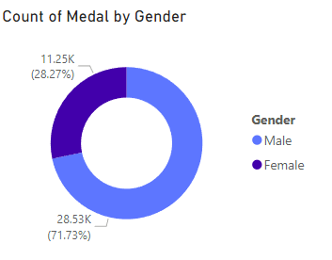
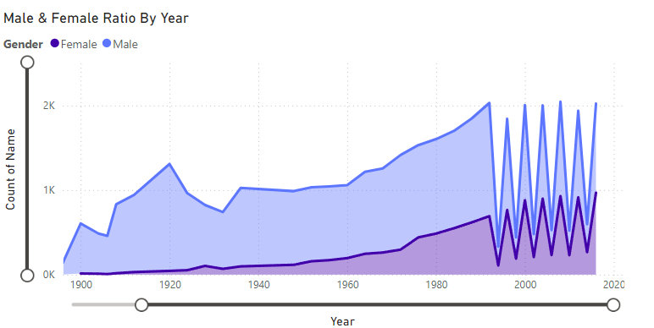
Male & Female Ratio By Year
Count of Medal by Gender

Slide 4
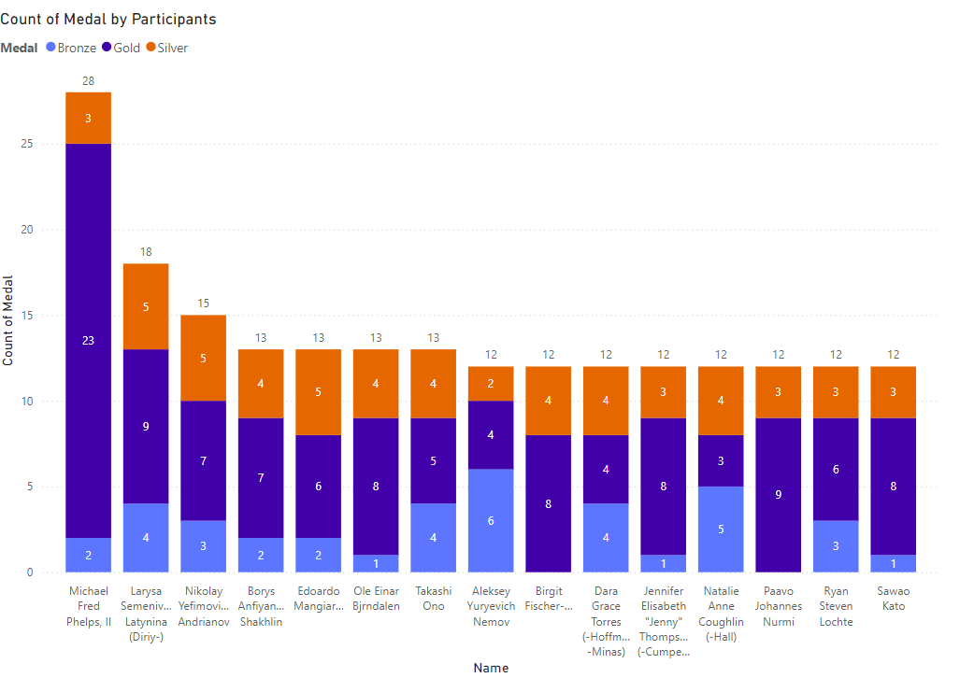
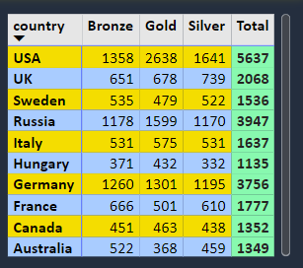
Top 10 Countries By Medal
Count of Medal by Participants

Slide 5
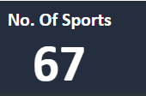
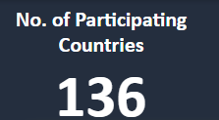
No. of Participating Countries
No. of Sports

Slide 6
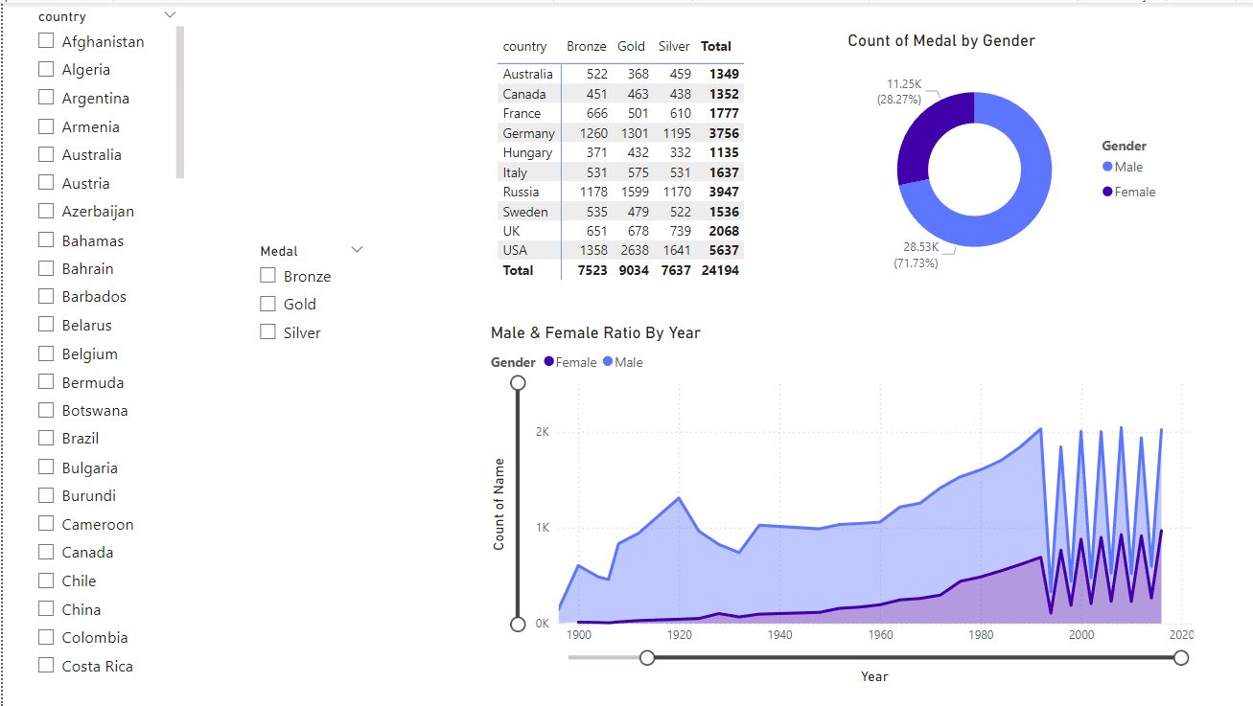
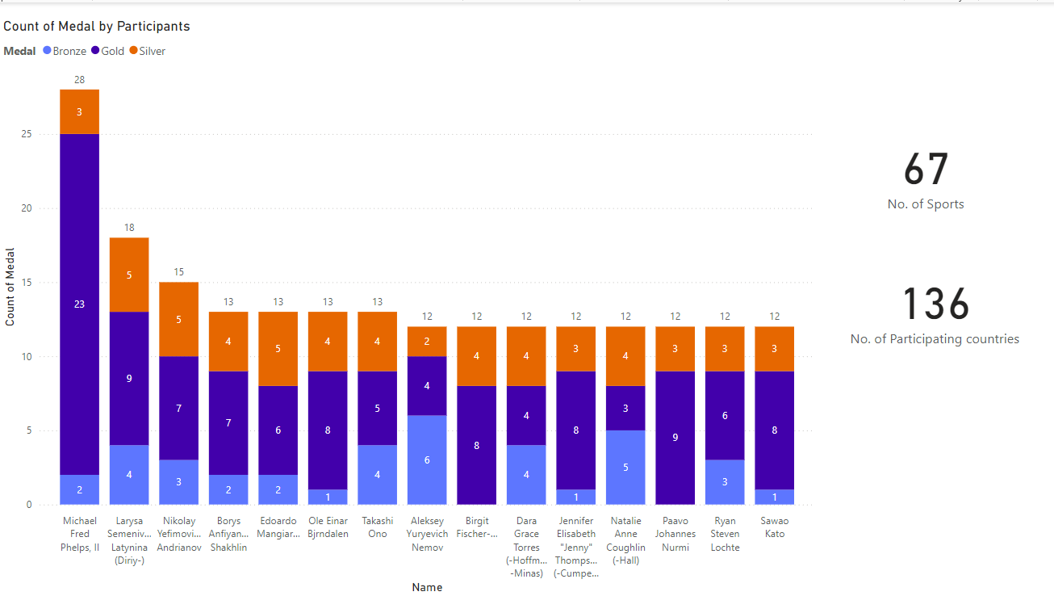

Slide 7
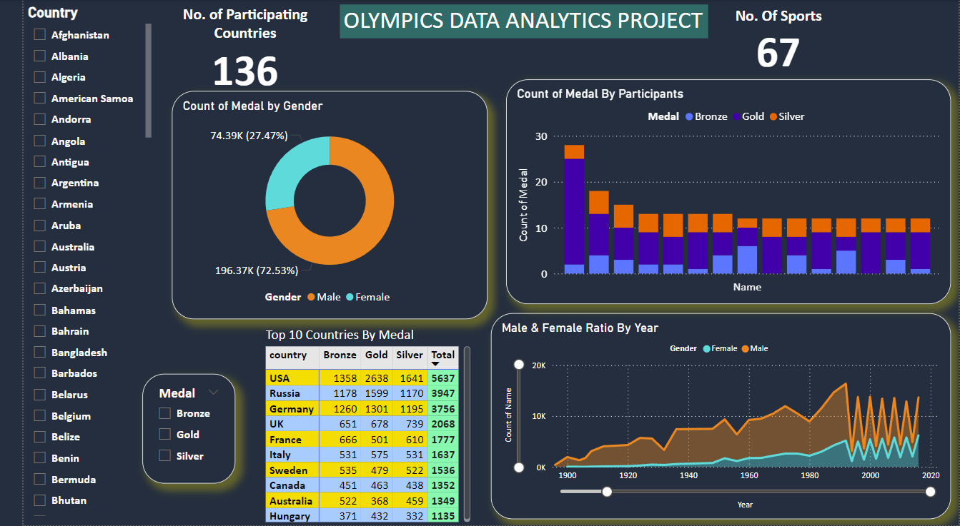
OLYMPICS DATA ANALYTICS DASHBOARD

Slide 8
Insight-
The Olympics promote fairness and greatness.
136 total number of participating countries, 67 sports come together.
Top medal winners: USA, Russia,Germany.
Michael Phelps: most decorated Olympian (28 medals)
Larysa Semenivna Latynina : most medals won by a female (18), Inspiring future generations of female athletes.
Progress shows Olympics support equality.
Action Plan-
Make Olympic teams diverse and inclusive.
Use technology for global reach and new sports.

Slide 9
THANK YOU

